Slide 1
TERRE
TERritory, eneRgy & Employment
Analysis of renewable energy potential of functional areas
Joachim Hacker

Slide 2
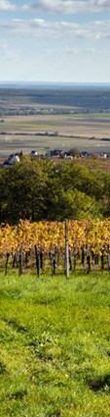
Workpackage 3 contents
WP3 - Analysis of renewable energy potential of functional areas
act. 3.1 – creation of a framework for a transnational approach towards local development through RES
act. 3.2 - Mapping renewable energy potentials & local multi-level resources
act. 3.3 - Elaboration of a decision support system to assess sustainable local development through RES

Slide 3
Workpackage 3 outputs and results
WP3 overview outputs- results
WP 3 | Outputs / results
output | Guideline about transnational mapping approach
output | Local reports covering all aspects related to RES
output | Transnational Comparison report on RES potential & socio economic & environmental analysis of territories involved
output | Decision Support System (DSS) for supporting partners to structure and assess the sustainability and feasibility of strategies of local development based on RES implementation projects
result | Set of scenarios on RES potential and socioeconomic and environmental impacts on territories available by the involved administrations after using the DSS
result | TERRE's Transnational model related to the sustainable exploitation of RES as engine for the local development (to be used as driver for the preparation of the local plans in WP4)

Slide 4
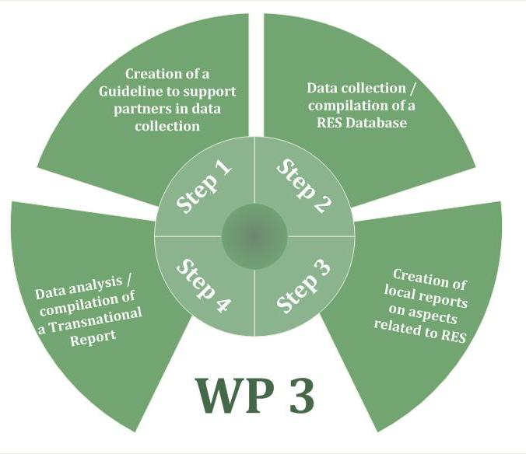
Transnational Comparison of RES potentials
WP3 Analysis of renewable energy potential of functional areas

Slide 5
Workpackage 3 Step 1
WP3 – Step 1 Guideline for RES analysis in the project areas
Guideline based on 5 questions:
What is the available theoretical renewable energy potential from different sources in each pilot area?
What is the RES potential already in use? Are there any conflicts or barriers arisen from current uses?
What is the remaining/realizable potential?
What are the characteristics of the areas (environmental and landscape dynamics)?
Who is involved in the RES process? Who is producing RES and affected by RES production? Who might be involved in RES? (stakeholders and target groups)

Slide 6
Workpackage 3 Step 2/3
WP3 – Step 2 / 3 RES Database and Local Reports of the territories
Analysis in the following projectregions
1 | Province of Rimini (IT) (LP) | Alta Valmarecchia
2 | Province of Rovigo (IT) | Rovigo
3 | Municipality of Újszilvás (HU) (PP 3) | Ujszilvas
4 | Szolnok (HU) (PP4) | Szolnok
5 | EEE (AUT) (PP6 ) | Burgenland
6 | TOB (AUT) (PP5) | Burgenland
7 | Odorheiu Scuiesc (RO) | Odorheiu Secuiesc
8 | Municipality Dimitovgrad (BG) (PP9) | Dimitovgrad
9 | Centre for Sustainable Rural Development Kranj (SLO) | Gorenjska Region
10 | IRENA (HR) (IPA 1) | Istria
11 | LIR (Bosnia-Herzegovina) (IPA 2) | Republika Srbska
12 | Chamber of Commerce and Industry of Tirana (Albania) | Tirana

Slide 7
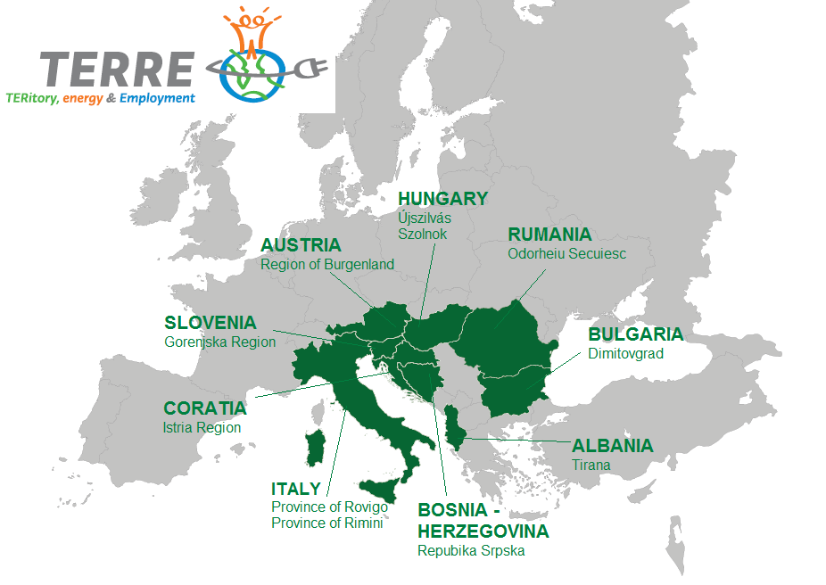
Workpackage 3 Step 2/3
WP3 – Step 2 / 3 RES Database and Local Reports of the territories

Slide 8
Step 4
Transnational Comparison Report
WP3 – Step 4 Transnational Comparison Report
aim was to give an overview about the RES potentials in the SEE area of the involved partner territories
focus lied on the possibilities of regional development by RES implementation & consideration of socio-economic effects
data of all databases and local reports have been combined - strengths and weaknesses of the regions have been faced
scenarios have been evaluated

Slide 9
Step 4
Transnational Comparison Report
WP3 –SEE Transnational Comparison Report
Results: Main potentials in the SEE TERRE project regions are in the field of agriculture, forestry and solar energy

Slide 10
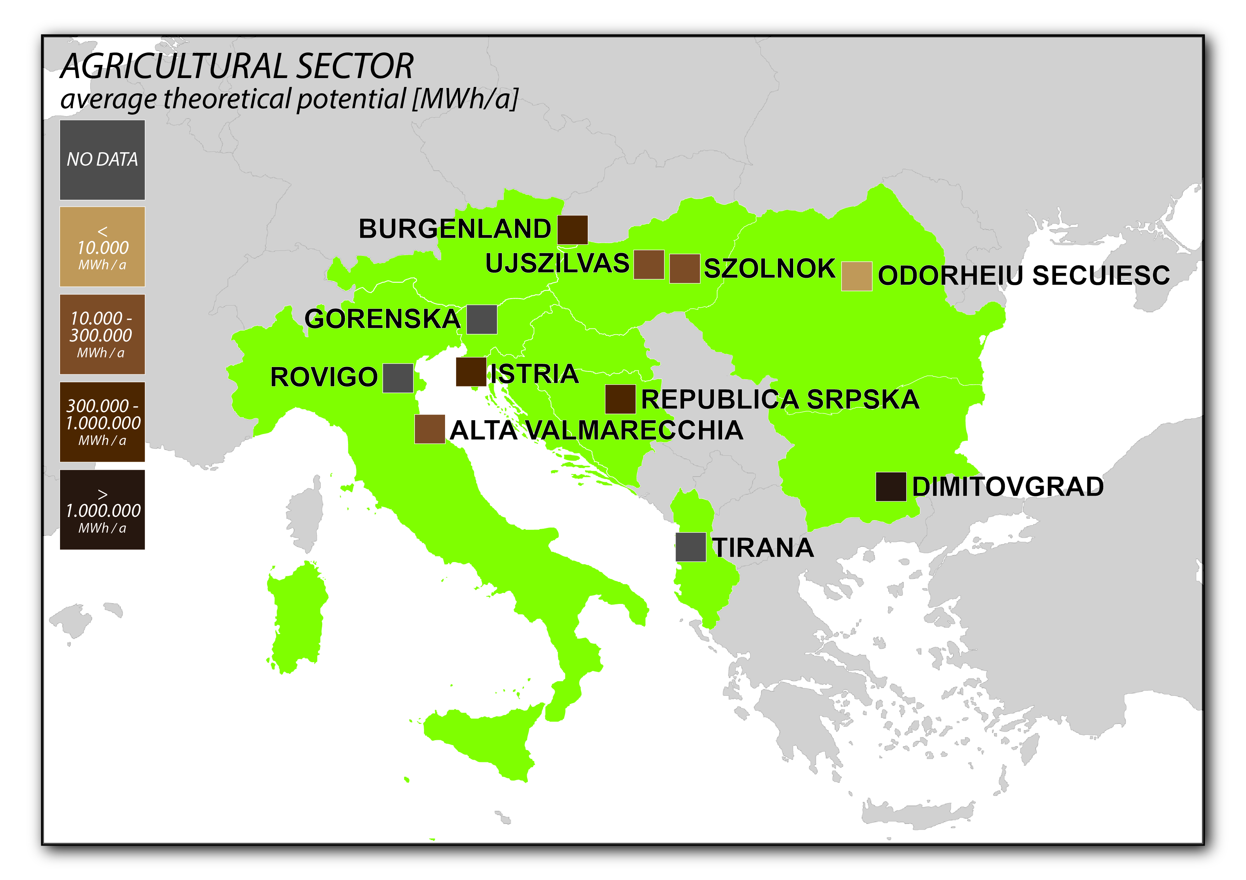
Step 4
Transnational Comparison Report
WP3 –SEE Transnational Comparison Report
Map shows that the majority of the involved TERRE partner regions have quite a lot of existing potentials in the agricultural sector

Slide 11
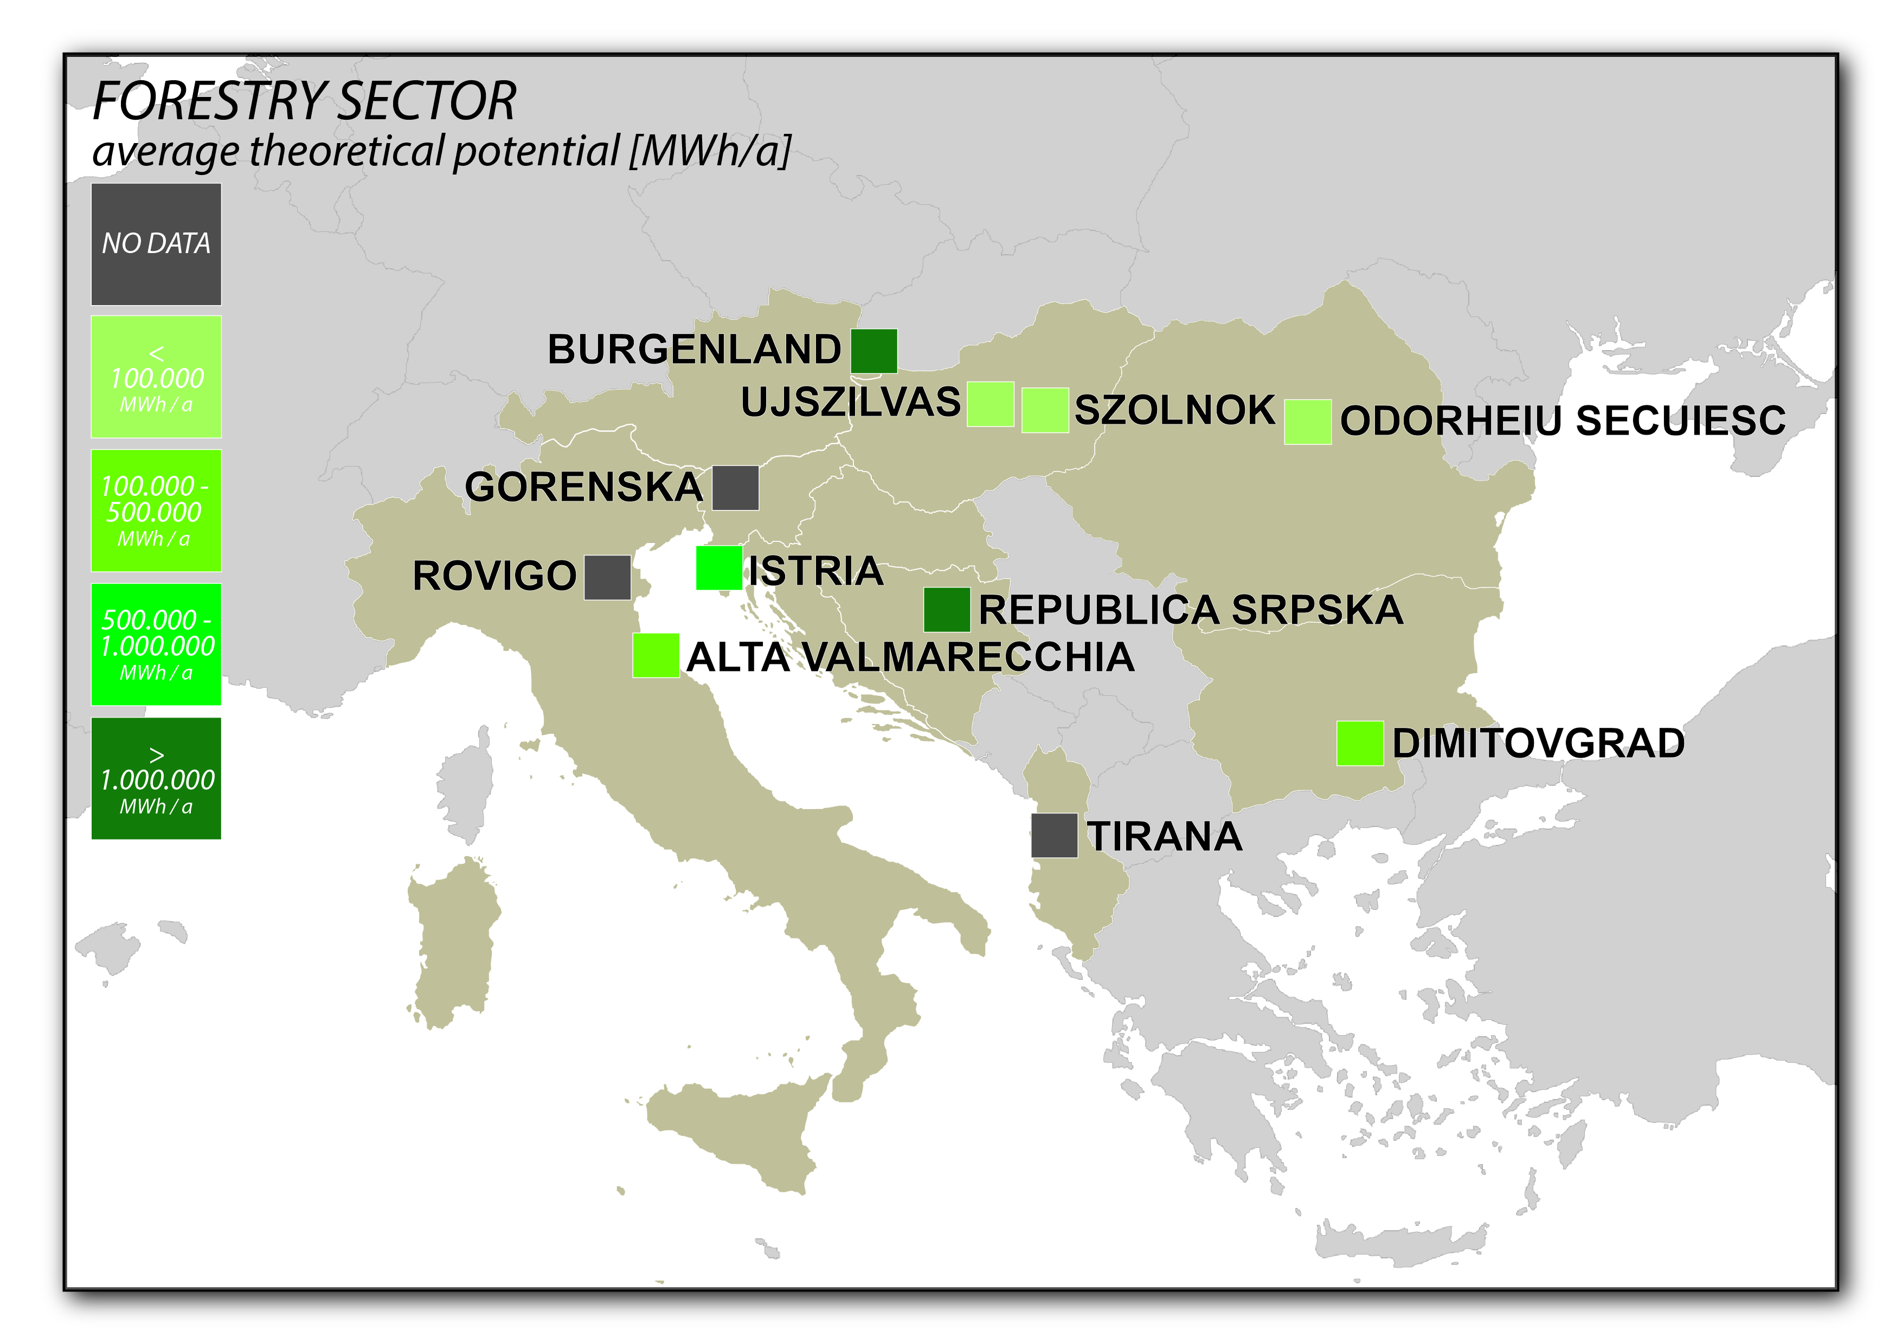
Step 4
Transnational Comparison Report
WP3 –SEE Transnational Comparison Report
Map shows that there is a quite good mix of regions that really have a huge potential on forestry biomass, some that are quite in the middle and some with less amounts

Slide 12
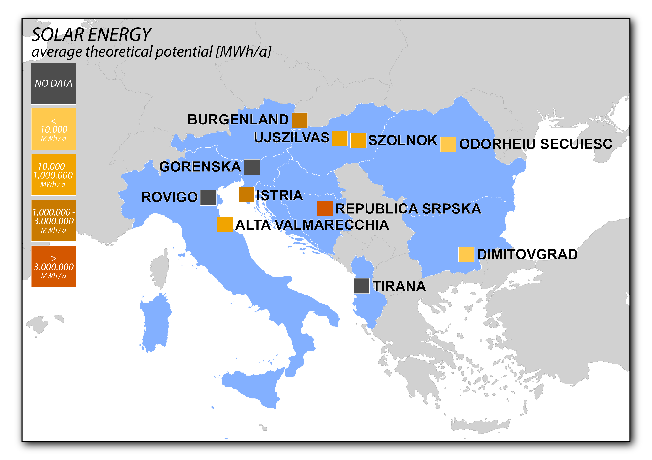
Step 4
Transnational Comparison Report
WP3 – SEE Transnational Comparison Report
Map shows that there is a similar picture given when the solar energy potentials are considered

Slide 13

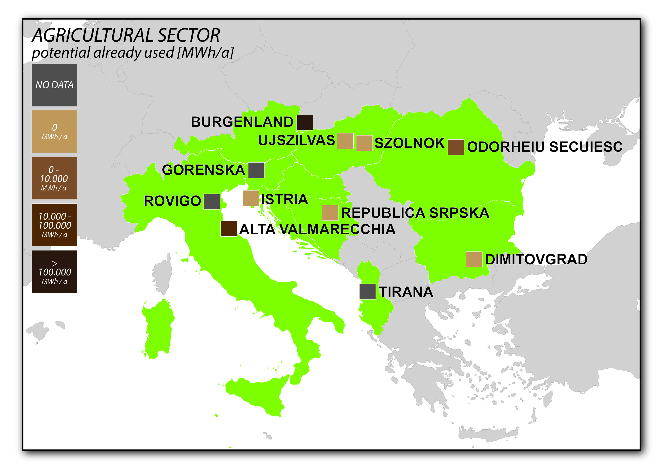

Step 4
Transnational Comparison Report
WP3 –SEE Transnational Comparison Report
Furthermore the actual use of RES
potentials was analyzed
agricultural sector has the highest
amount of theoretical potential in all
territories involved, but is only used
in some regions
forestry sector has very strong
usage within those project regions
where also the most potentials are
given
the analysis of solar energy shows
that there are very big amounts of
potentials given, but actually a very
small rate of solar energy use

Slide 14
Set of
Scenarios
WP3 – Set of Scenarios
Development of scenarios based on RES potentials resulting from the local analysis / local reports
Within a workshop this ideas have been discussed and scenarios have been developed
Scenarios have been the basis to develop local strategies and financial plans
Each partner had to develop ideas by communicating with stakeholders, target groups etc. in which direction the development of each region can occur

Slide 15
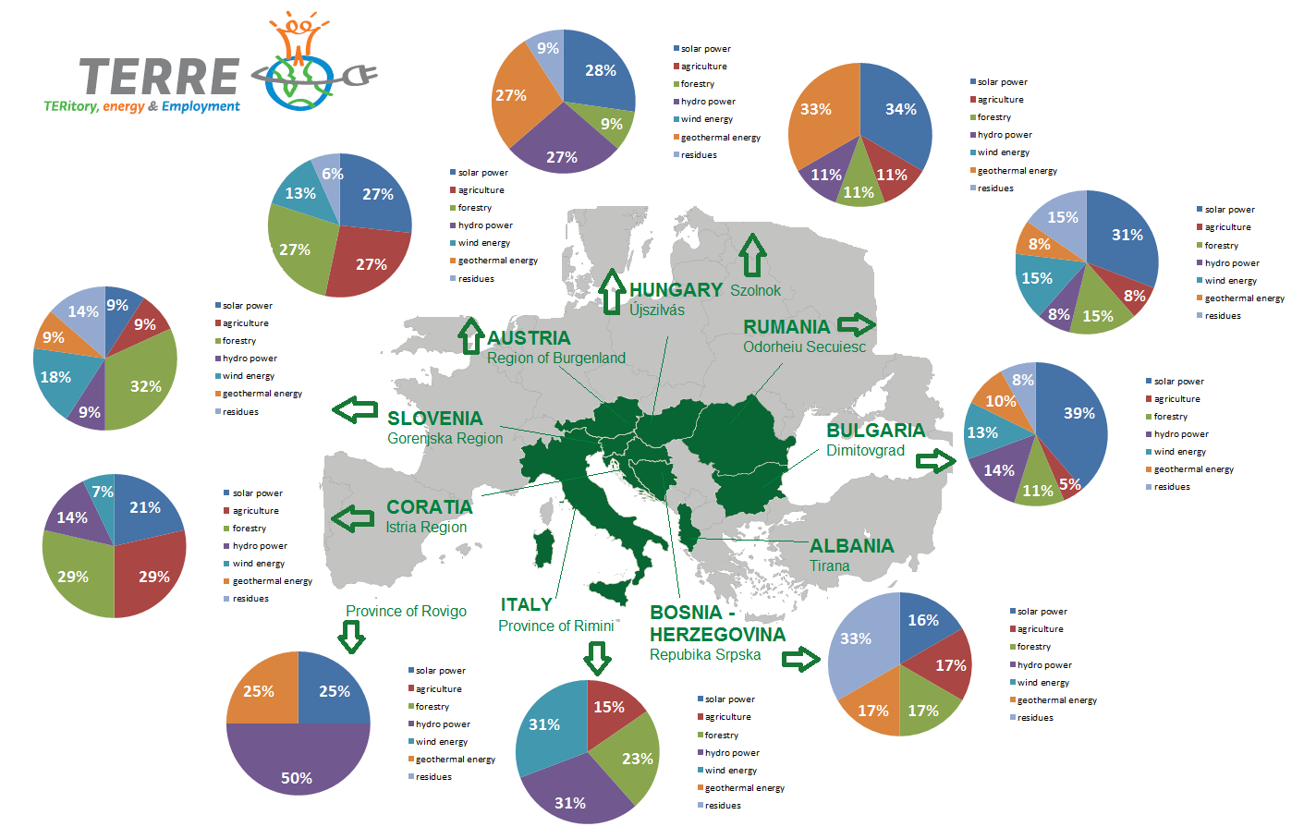
Set of
Scenarios

Slide 16
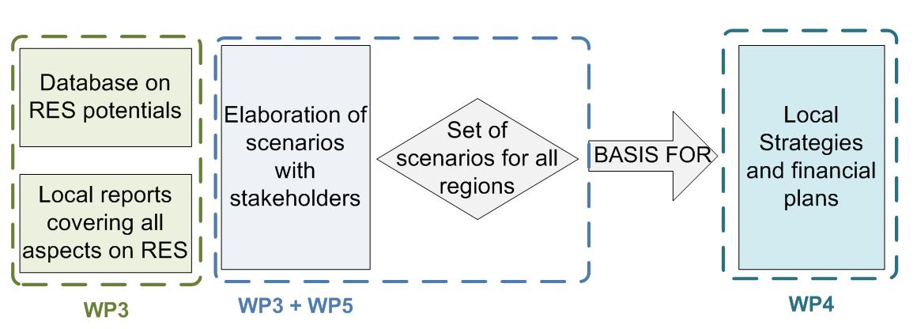
Results / further steps
WP3 – Analysis of renewable energy potential of functional areas

Slide 17
THANK YOU FOR YOUR ATTENTION
European Centre for Renewable Energy Güssing Ltt.
Europastraße 1
7540 Güssing
www.eee-info.net
Tel.: 03322 / 9010 850- 0
Fax: 03322 / 9010 85010
Email: office@eee-info.net

